Slide 1

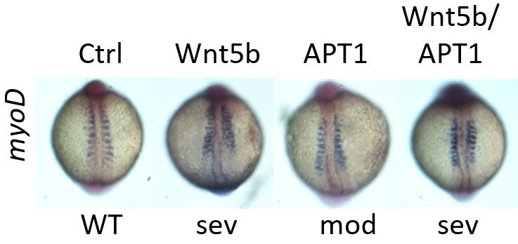
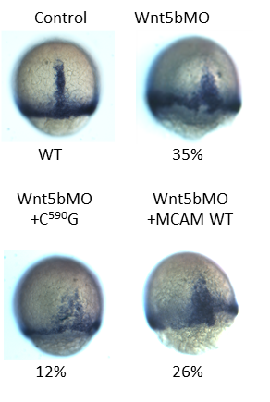
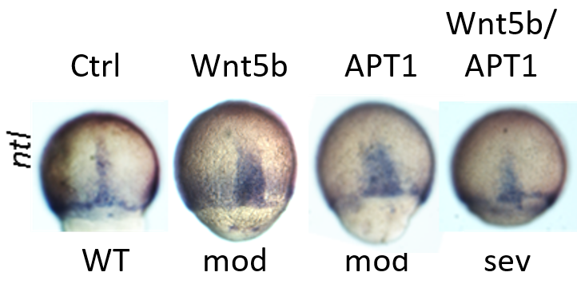
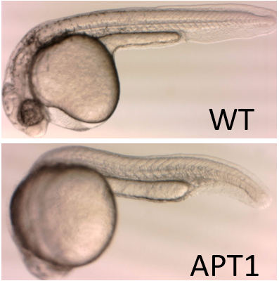
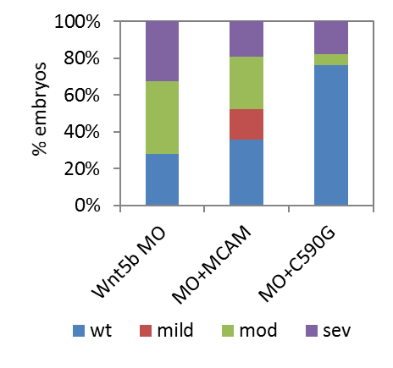
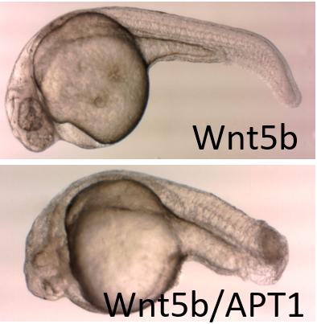
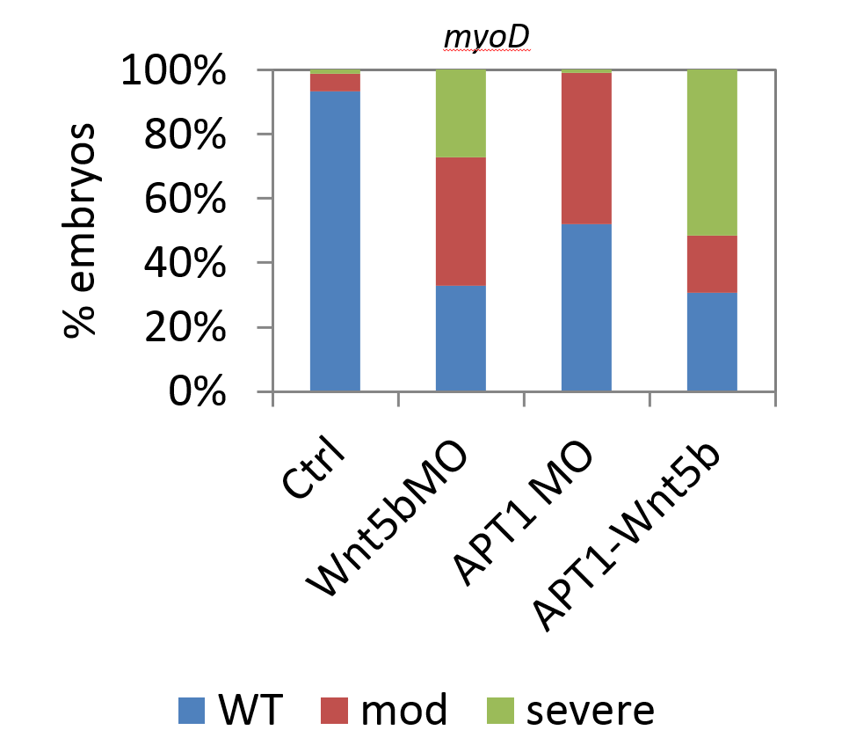
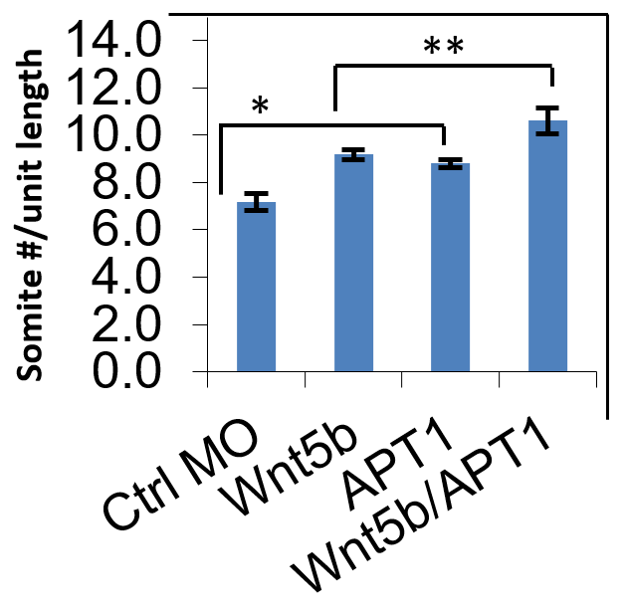
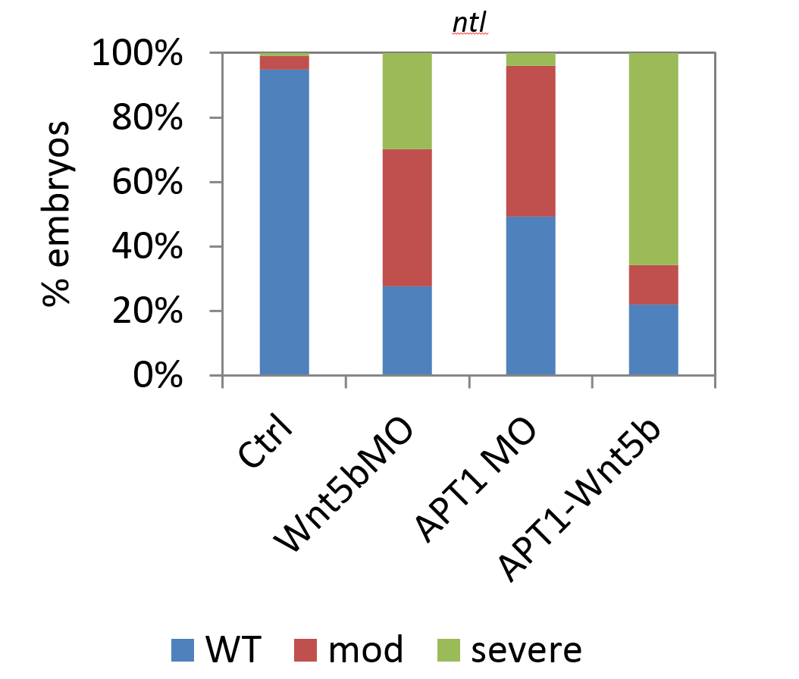
Wnt5a induced protein depalmitoylation is required for cell movement in Zebrafish (Danio Rerio).
Phillip Bax⁴, Elizabeth J. Billquist, Aaron P. Putzke^{3,}, Eric S. Witze^{1, 2}
Department of ¹Cancer Biology, ²Abramson Family Cancer Research Institute, Perelman School of Medicine, University of Pennsylvania
³Department of Biology Whitworth University, Spokane, WA 99251,
0
Abstract
A
Expression of C⁵⁹⁰G MCAM partially rescues
Wnt5b morpholino
Polarized cell movement is critical for embryonic development and metastatic disease. The noncanonical Wnt pathway regulates cell polarity and polarized cell movement, but the molecular mechanisms are not well understood. We find that protein depalmitoylation promotes cell migration/invasion during embryonic morphogenesis and cancer cell invasion. Additionally, Wnt5a promotes depalmitoylation of the melanoma cell adhesion molecule (MCAM) and a point mutation in cysteine 590 specifically blocks MCAM palmitoylation. This mutation increases dynamic polarized MCAM localization and cell invasion. Directly altering expression of the basal protein palmitoylation machinery is sufficient to augment directional cell movement in three dimensional collagen invasion assays and during Wnt regulated morphogenic cell movement in zebrafish embryos. Additionally, tumor derived mutations in palmitoyl transferases also decrease protein palmitoylation and have impaired ability to suppress cell invasion. Our results suggest that protein depalmitoylation is required for efficient directional cell movement during vertebrate morphogenesis and in cancer progression.
Figure 6. In situ hybridization shows that the palmitoylation resistant mutant MCAM C⁵⁹⁰G decreases percent of embryos showing severe phenotype when co-injected with Wnt5b. To further define the role of protein depalmitoylation during convergent extension cell movements the sufficiency of the palmitoylation resistant MCAM mutant to rescue the Wnt5b morpholino phenotype was tested. Since Wnt5a treatment increases depalmitoylation of MCAM in cultured cells we hypothesized that expression of the palmitoylation resistant form of MCAM might be sufficient to bypass Wnt5b inhibition in zebrafish. Embryos were co-injected with mRNA encoding the palmitoylation resistant C590G mutant MCAM-GFP and the Wnt5b morpholino. To measure the degree of rescue, embryos were stained for ntl mRNA by in situ hybridization and the phenotype of each embryo was categorized as wild type or as showing mild, moderate or severe defect.
B
Wnt5b and APT1 Morpholinos
Inhibit Convergent Extension
Figure 3. Expression of (A) myo D and (B) ntl at 10-somite stage and 90% epiboly respectively as detected by in situ hybridization. In order to confirm that the A/P axis was shortened due to convergent extension defects, expression of the transcription factor myo D in the somites and notochord Zebrafish embryos were injected with control, Wnt5b morpholino, APT1 morpholino, and Wnt5b; APT1 morpholino and examined at the earlier 10-somite and 90%epiboly stages. In situ hybridization was then used to stain myoD expressing cells associated with somites for the 10-somite embryos and ntl expressing cells associated with migrating tissues during gastrulation for the 90% epiboly embryos. The Wnt5b and APT1 morpholino oligos were shown to result in the compression of somites in 10-somite embryos and impaired gastrulation movements in 90% epiboly embryos. The embryos were categorized by the extent to which they exhibited these phenotypes as wild type (WT), moderate, or severe.
Figure 1. Morphology of Zebrafish embryos injected with control, Wnt5b morpholino, APT1 morpholino, and Wnt5b; APT1 morpholino at 24 hours post fertilization (hpf). In both Wnt5b morpholino and APT1 morpholino injected embryos we observed a shortened A/P axis with ventrally bent tails that closely resemble the morphology of the Wnt5b mutant pipetail and the Wnt5b morpholino phenotype at 24 hpf, suggesting that the inhibiting Wnt5b and APT1 translation interferes with convergent extension. The phenotype was observed to be more severe when the embryos were co-injected with both the Wnt5b and APT1 morpholinos.
Figure 7. Phenotype of embryos injected with Wnt5b MO (n=54), Wnt5b MO+C590G MCAM-GFP (n=82), and Wnt5b+WT MCAM mRNA (n=77). The embryos co-injected with Wnt5b morpholino and C⁵⁹⁰G MCAM-GFP mRNA showed a decrease in the percentage of embryos with severe migration defects of ntl expressing cells (12.2% of embryos) compared to embryos injected with Wnt5b morpholino alone (35.1% of embryos). In embryos co-injected with Wnt5b morpholino and WT MCAM-GFP mRNA the percentage of embryos displaying the severe defect in cell migration was only slightly reduced (26.0% of embryos).
Figure 4. Expression of myoD at the 10 somite stage detected by in situ hybridization. (Ctrl n=90, Wnt5bMO n=70, APT1MO n=104, APT1-Wnt5bMO n=62). In situ hybridization showing expression of MyoD at the 10-somite stage was used to classify the phenotype of the embryos injected with control, APT1 morpholino, Wnt5b morpholino, and APT1; Wnt5b morpholino, which can be seen in Figure 3 A. Embryos injected only with APT1 experienced only moderate compression of the somites with some lateral expansion of myoD expressing cells, while some of the Wnt5b embryos experienced a severe phenotype and those co-injected with both morpholinos experienced the highest percentage of embryos with severe phenotypes.
Conclusions and Continuing Work
Figure 2. The number of somites per unit length (626 pixel) was determined for 10-somite stage embryos (*P=4.4x10⁻⁵, **P=9.6x10⁻³, Student’s T-test). In order to quantify the severity of the shortening of the anterior/posterior axis due to APT1 and Wnt5b Morpholinos, the number of somites per unit length was determined for four samples of 10-somite stage embryos which were injected with control, Wnt5b morpholino, APT1 morpholino or Wnt5b; APT1 morpholino. Embryos injected with the APT1 morpholino had more somites per unit length (8.18, ±1.07 s.d) compared to control morpholino embryos (7.16, ±0.39 s.d; Student’s T-test, P=4.4x10-5) (Fig. 6B). When APT1 and Wnt5b morpholinos are co-injected the loss of APT1 enhanced the Wnt5b phenotype with embryos displaying a greater number of somites per unit length (10.61, ±1.07 s.d,) compared to Wnt5b morpholino alone (9.18, ±0.39 s.d; Student’ T-test, P=9.6x10-3) . The compressed anterior/posterior axis is suspected to be a result of impaired gastrulation movements.
Decreasing protein depalmitoylation through the inhibition of APT1 results in a decrease in cell movement, resulting in the disruption of convergent extension defects and a shortened anterior-posterior axis in zebrafish embryos.
The ability of the C⁵⁹⁰G mutation to partially rescue the Wnt5b morpholino phenotype implicates depalmitoylation of cell adhesion molecules as a mechanism for facilitating Wnt regulated convergent extension cell movements.
Future work includes determining the specificity of APT1. It is possible that overexpression of APT1 may simply decrease the total levels of palmitoylated surface receptors like MCAM and CD44 causing increased cell invasion.
Figure 5. Expression of transcription factors no tail (ntl) at approximately 90% epiboly detected by in situ hybridization. (Ctrl n=97, Wnt5aMO n=87, APT1MO n=128, APT1-Wnt5bMO n=41). The position of migrating chordamesoderm cells were visualized by in situ hybridization of the transcription factor no tail (ntl) (as can be seen in Figure 3B). The localization of ntl confirmed impaired gastrulation movements with decreased migration of ntl expressing cells forming a shorter and wider area in Wnt5b and APT1 morpholino injected embryos compared to control embryos. Embryos co-injected with both Wnt5b and APT1 morpholino displayed expression patterns of ntl and myoD that were more severely altered in a higher percentage of embryos than embryos injected Wnt5b morpholino alone (ntl – 65.9% versus 29.9%, myoD - 51.5% versus 27.1%)
Acknowledgements
Murdock Charitable Trust Grant to AP
National Science Foundation-funded REU 0754293
National Science Foundation-funded MRI 1335890
HHMI Faculty Development Grant to AP and JM
Members of the Putzke lab
Notes:
46w x 40h

